Slide 1
Gentrification and Citizenship
UP 494 : Neighborhood Analysis
Rosario Barrera

Slide 2
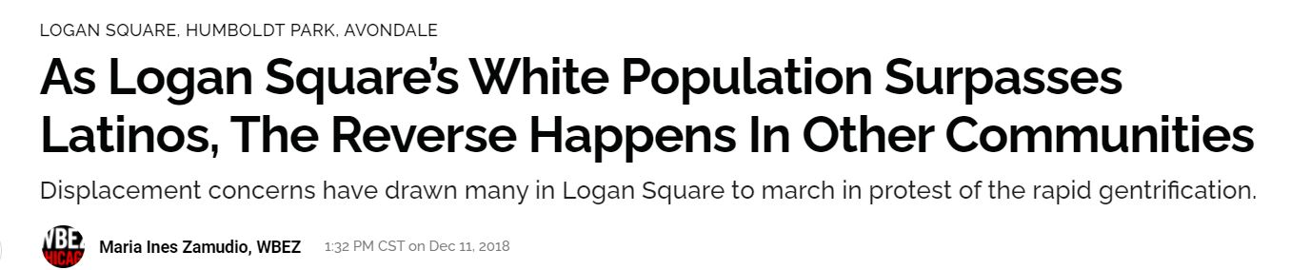
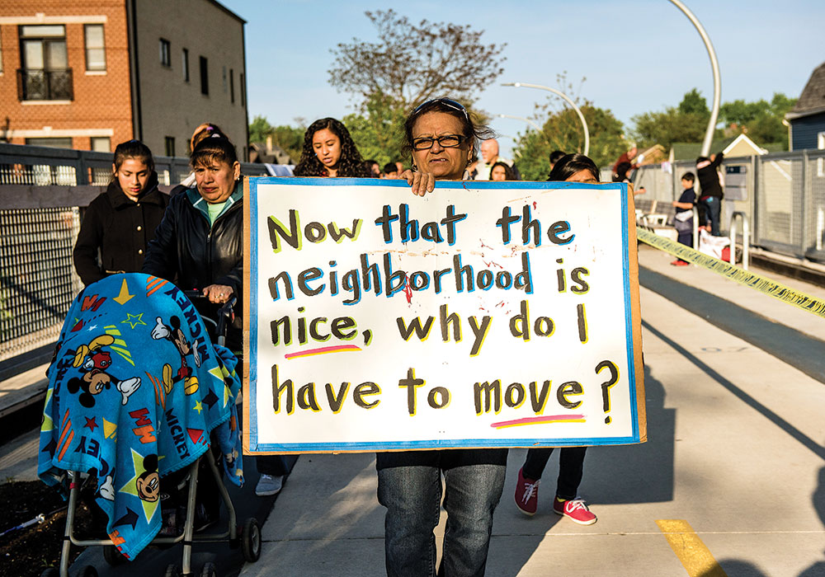
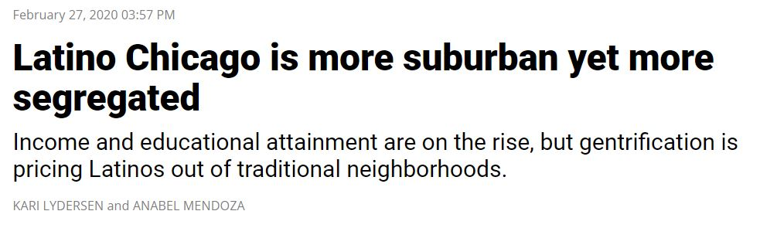
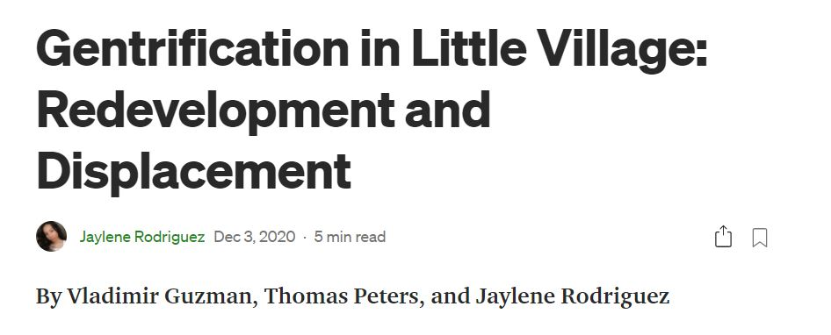
Notes:
As Latinos are being priced out of neighborhoods, it made me think about financial resources they do or don’t have to help them out. What about access to affordable housing ? Chicago Housing Authority, or other housing authorities?

Slide 3
Citizenship and Policy Implications
The 1996 welfare law created two categories for immigrants to determine their eligibility to welfare services. However, the law excluded most people in both groups from welfare programs.
The following immigrants are eligible:
“lawful permanent residents,
refugees, people granted asylum or withholding of deportation/ removal and conditional entrants
people granted parole by the U.S Department of Homeland Security or a period of at least one year
Cuban or Haitian entrants
certain abused immigrants, their children, and/or their parents
certain survivors of trafficking.”
Noncitizens do not have access to welfare programs including
SNAP
TANF
Social Security Benefits
Public Housing
Notes:
After some research, I found this:
Public housing as a resource to mitigate the effects of gentrification
Being a noncitizen can make people more vulnerable to gentrification

Slide 4
Research Question
Is there a relationship between citizenship and gentrifying neighborhoods?
Focus Area: Chicago, Illinois
Notes:
Being a noncitizen can make people more vulnerable to gentrification

Slide 5
Definitions
Gentrification: a process of neighborhood change that includes economic change in a historically disinvested neighborhood —by means of real estate investment and new higher-income residents moving in - as well as demographic change - not only in terms of income level, but also in terms of changes in the education level or racial make-up of residents. (urbandisplacement.org)
Displacement - “Displacement can happen in many ways: direct displacement, in which residents are forced to move out because of rent increases, building rehabilitation, or a combination of both; exclusionary displacement, in which housing choices for low-income residents are Displacement of Lower-Income Families in Urban Areas Report 5 limited; and finally displacement pressures, when the entire neighborhood changes and the services and support system that low-income families relied on are no longer available to them,” (Slater, 2009).

Slide 6
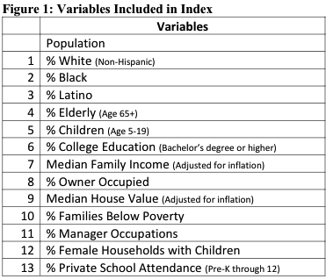
Voorhees Gentrification Index
A clear and concise way to measure gentrification was created by the Center for Neighborhood and Community Improvement at the University of Illinois at Chicago by Natalie Vorhees
I am using these exact variables to replicate and measure gentrification throughout Chicago to see how different communities compare and whether citizenship plays a crucial role in the gentrification process

Slide 7
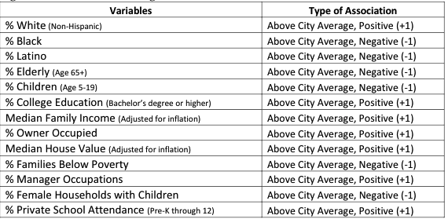
The Gentrification Index
Variables that indicate gentrification are positive
Variables that indicate decline are negative
Composite scores will determine the typology of the community
Community Area variables are compared to city wide data
Total score of 7 + indicates gentrification
Total score of -7 + indicates decline
Total Score between 6 and -6 indicates No Change

Slide 8
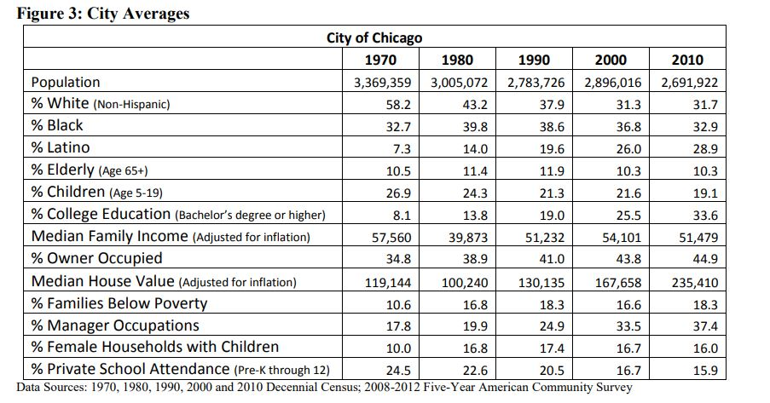
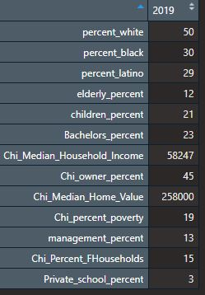
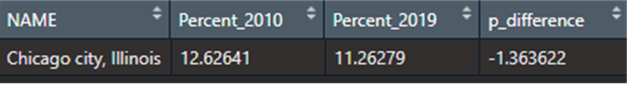
City Averages

Slide 9
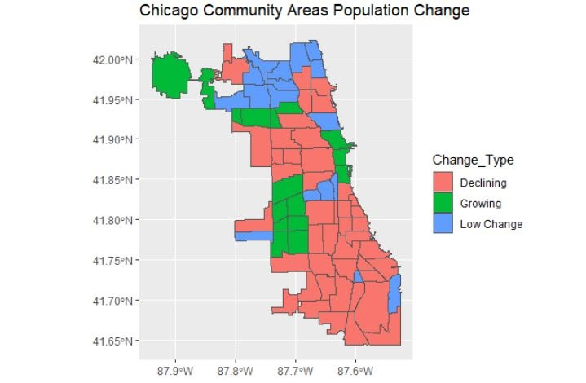

Slide 10
Conclusions and Further Work
This research left me with more questions than answers: as an urban planner what can we do to make public housing more accessible to noncitizens vulnerable to gentrification?
What role do banks have in the process of gentrification
Denying home loans to noncitizens ?

Slide 11
Questions?

